Slide 1
OPERATORS In Java Script
Java script language supports following operators
1. Arithmetic Operators
2. Relational (comparison) operators
3. Logical operators
4. Assignment operators
5. Conditional operators
6. The + operator used on strings

Slide 2
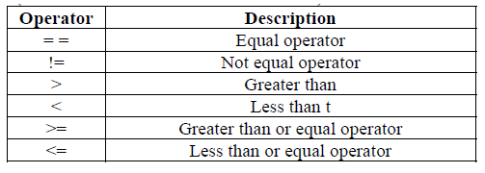
Relational Operators:
Relational operators compare operands and returns a logical value either (true/false)

Slide 3
<html>
<head> <title> Mathematical Functions </title></head>
<body>
<h1 align=center><u> Mathematical Functions </u></h1>
<script language="JavaScript">
var a = parseInt(window.prompt(" Enter a value "));
var b = parseInt(window.prompt(" Enter b value "));
document.writeln("a value is:",a);
document.writeln("<br> b value is:", b);
document.writeln("<br>", a>b);
document.writeln("<br>", a<b);
document.writeln("<br>", a>=b);
document.writeln("<br>", a<=b);
document.writeln("<br>", a==b);
document.writeln("<br>", a!=b);
</script>
</bdoy>
</html>

Slide 4
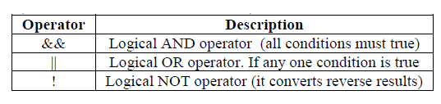
Logical Operators:
Logical operators are typically used with Boolean values and returns either true or False.

Slide 5
<html>
<head> <title> Mathematical Functions </title></head>
<body>
<h1 align=center><u> Mathematical Functions </u></h1>
<script language="JavaScript">
var a = parseInt(window.prompt(" Enter a value "));
var b = parseInt(window.prompt(" Enter b value "));
document.writeln("a value is:",a);
document.writeln("<br> b value is:", b);
var c=(a<b)&&(a!=b)
document.writeln("<br>", c);
var c=(a<b)||(a!=b)
document.writeln("<br>", c);
var c=!(a<b)
document.writeln("<br>", c);
</script>
</bdoy>
</html>

Slide 6
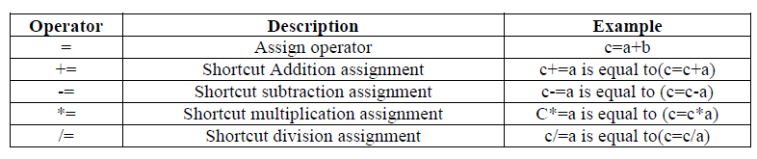
Assignment Operators:
The assignment operators(=) to assign a value to a variable or constant or expression assigned for given variable

Slide 7
<html>
<head> <title> Mathematical Functions </title></head>
<body>
<h1 align=center><u> Mathematical Functions </u></h1>
<script language="JavaScript">
var a = parseInt(window.prompt(" Enter a value "));
var b = parseInt(window.prompt(" Enter b value "));
document.writeln("a value is:",a);
document.writeln("<br> b value is:", b);
b+=a;
document.writeln("<br> After changing b=", b);
b-=a;
document.writeln("<br> After changing b=", b);
b*=a;
document.writeln("<br> After changing b=", b);
b/=a;
document.writeln("<br> After changing b=", b);
b%=a;
document.writeln("<br> After changing b=", b);
</script>
</bdoy>
</html>

Slide 8
Conditional Operator(?:) :
Conditional operator is used for comparing two expressions, also contains a conditional operator that assigns a value to a variable based on some condition
Syntax: variable = (condition)? Value1:value2;

Slide 9
<html>
<head> <title> Mathematical Functions </title></head>
<body>
<h1 align=center><u> Mathematical Functions </u></h1>
<script language="JavaScript">
var a = parseInt(window.prompt(" Enter a value "));
var b = parseInt(window.prompt(" Enter b value "));
document.writeln("a value is:",a);
document.writeln("<br> b value is:", b);
var c=(a<b)?"B is Big":"A is Big";
document.writeln("<br> ",c);
</script>
</bdoy>
</html>

Slide 10
The “+” operator used on strings:
The ‘+’ operator can also be used to add string variables or text values together and it also known as string concatenation.

Slide 11
<html>
<head> <title> Mathematical Functions </title></head>
<body>
<h1 align=center><u> Mathematical Functions </u></h1>
<script language="JavaScript">
var a = window.prompt(" Enter first string ");
var b = window.prompt(" Enter second string ");
document.writeln("First String is:",a);
document.writeln("<br> Second String is:", b);
var c=a+b;
document.writeln("<br> After concatination String is: ",c);
</script>
</bdoy>
</html>

Slide 12
FUNCTIONS IN JavaScript
A function is a piece of code that performs a specific task. You may call a function from anywhere within a page.
Functions can be defined both in the <head> and as well as in the <body> section of a document.
Defining Functions:
Functions are defined using the “function” key word. The function name can be any combination of digits, letters and underscore but not a white space
Syntax:
function function name (parameters….)
{
Body of function…..
}

Slide 13
Example 1
<html> <head>
<title> Strong Numbers </title>
<script type="text/javascript">
function f1(){
document.write("Welcome to Functions");
}
</script>
</head>
<body onload="f1()">
</body>
</html>

Slide 14
<html> <head>
<title> Strong Numbers </title>
<script type="text/javascript">
function f1(){
document.write("Welcome to Functions");
}
</script>
</head>
<body>
<form name="form1">
<input type="button" value="Click" onclick="f1()">
</form>
</body>
</html>
Example 2

Slide 15
Example 3 passing arguments
<html> <head>
<title> Strong Numbers </title>
<script type="text/javascript">
function f1(a,b){
document.write(a+b);
}
</script>
</head>
<body>
<form name="form1">
<input type="button" value="Click" onclick="f1(10,20)">
</form>
</body>
</html>

Slide 16
Example 4 passing arguments and return value
<html> <head>
<title> Strong Numbers </title>
<script type="text/javascript">
function f1(a,b){
return (a*b);
}
</script>
</head>
<body>
<script type="text/javascript">
document.write("Product of two numbers=",f1(10,20));
</script>
</body>
</html>

